Slide 1
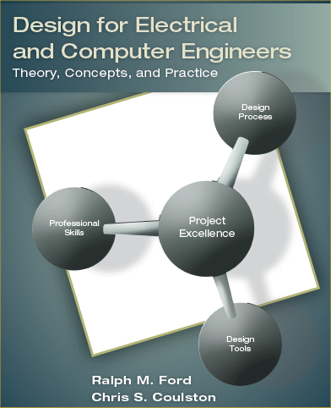
Chapter 6 – System Design II: Behavioral Models

Slide 2
5.5 Application: Digital Design - Stopwatch
Requirements: The system must
have no more than two control buttons;
implement three functions (run, stop, and reset);
output a 16 bit binary number that represents seconds elapsed.

Slide 3
Level 0
Module | Stopwatch
Inputs | A = Reset button signal. When the button is pushed it resets the counter to zero. B = Run/stop toggle signal. When the button is pushed it toggles between run and stop modes.
Outputs | b₀-b₁₅. 16 bit binary number that represents the number of seconds elapsed.
Functionality | The stopwatch counts number of seconds after the run button (B) is pushed and system is either in reset or stop mode. When in run mode and the stop button (B) is pushed, it stops the count. A reset button (A) push will reset the output value of the counter to zero only when in stop mode.

Slide 4
Level 1

Slide 5
Module | Finite State Machine
Inputs | A. Signal to reset the counter signal. B. Signal that provides a toggle between run and stop modes.Clock. 1Hz clock signal.
Outputs | Reset. Signal to reset the counter to zero. Control. This signal enables or disables the counter.
Functionality

Slide 6
Motivation
Functional Design
Appropriate for function-oriented systems: inputs, outputs, and some transformation between them.
There are other types of system behavior that designers need to be able to understand.
State behavior
Logic and flow
Data flow
Database relationships
…

Slide 7
Learning Objectives
By the end of this chapter, you should:
Have a familiarity with the following modeling tools for describing ECE system behavior: state diagrams, flowcharts, data flow diagrams, entity relationship diagrams, and the Unified Modeling Language.
Understand the intention and expressive power of the different models.
Understand the domains in which the models apply.
Be able to conduct analysis and design with the models.
Understand what model types to choose for a given design problem.

Slide 8

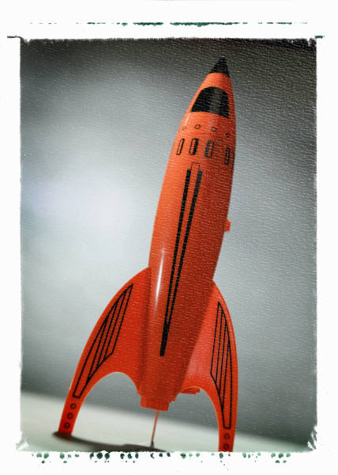
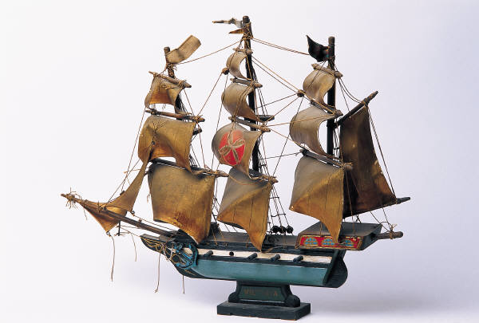
6.1 Models
Models - what do you think of?

Slide 9
Properties of Models
A good model should be
Abstract
Unambiguous
Allow for innovation
Standardized
Facilitate good communication
Modifiable
Remove unnecessary details & show important features
Break system into sub-problems.
Substitute sequence of actions by a single action.
Assist in verification
Assist in validation

Slide 10
Definitions
Model
Modeling Language
Object Type
Intention

Slide 11
6.2 State Diagrams
Intention is ?
How do you know if you should use one?

Slide 12
State Diagram Symbols

Slide 13
Example: Vending Machine

Slide 14
Example: Better Vending Machine
Consider the state diagram for the vending machine shown on previous page Figure 6.2. Now assume that the system accepts nickels, dimes, and quarters. Also assume that it is capable of returning change to the user after a purchase. Create a state diagram that represents this new system. Make sure to define the output signals and their value for each state.
Solve this individually in class – 5 minutes

Slide 15
6.3 The “Lowly” Flowchart
The intention of a flowchart is to model what type of behavior ???

Slide 16
Flowchart Symbols

Slide 17
Example: Light Monitoring System
Can you figure out the operation of the system by looking at this?
That is why the flowchart is elegant and not so lowly.

Slide 18
Example: Security Robot
Requirements (loosely)
Must roam randomly around facility
Detect intruders by recognizing sound
Set-off an alarm if detects noise, transmit position, and wait.
Must regularly conduct a self-test to determine if it is working properly.
Design Details
Has the three ultrasonic sensors and can measure distance to objects to the left, forward, and right.
Has a microphone that it uses to monitor sounds.
Problem: Develop a Flow Chart of its operation

Slide 19
6.4 Data Flow Diagrams
Intention is ???
DFDs can have levels, just like the functional

Slide 20
Example: The Pie Making Process

Slide 21
Example: The Pie Making Process

Slide 22
Example: Video Browsing System

Slide 23
Example: Video Browsing System

Slide 24
DFD – The Event Table
Event | Trigger | Process | Source
Annotate Video | New Video Arrival | Shot Boundary Detection | System
View Storyboard | Browse Request | Storyboard Preview | User
View Shot | Shot Preview Request | Shot Preview | User

Slide 25
6.5 Entity Relationship Diagrams
Intention of an ERD is
Entities =
Relationships =
Attributes =

Slide 26
ERD Symbols

Slide 27
Example: College Database System
 | Student | Course | Department
Student
Course
Department

Slide 28
College Database ERD

Slide 29
6.6 Unified Modeling Language
For object-oriented software design.
Value in applying it to ECE Systems.
Has 6 different views of systems (unified!).
Only an overview is provided here.

Slide 30
UML - Scenario
Pretty popular idea – web ordering of groceries followed by home delivery.
The “v-Grocer” system.
User has a barcode scanner connected to home computer.
They can scan a used item an automatically order it from the grocery store.
Place the order and groceries delivered at pre-arranged time.

Slide 31
Static View
Object view of software.
Classes represent
Data
Methods (functions) that operate on the data
Objects are
Can allow for different security levels.

Slide 32
Class Diagram

Slide 33
Use-Case View
Intention =
Characterized by a Use-Case Diagram

Slide 34
Use-Case Description
Use-Case | WebOrder
Actors | Customer, Database, and WebServer
Description | This use-case occurs when a customer submits an order via the WebServer. If it is a new customer, the WebServer prompts them to establish an account and their customer information is stored in the Database as a new entry. If they are an existing customer, they have the opportunity to update their personal information.
Stimulus | Customer order via the GroceryCart.
Response | Verify payment, availability of order items, and if successful trigger the AssembleOrder use-case.

Slide 35
State Machine View

Slide 36
Activity View
Intention = describe a sequence of activities needed to complete a task.

Slide 37
Interaction View
Intention = to show interaction between objects (when they must cooperate to do something useful).
Use either a collaboration or sequence diagram.
This example is for the WebOrder use-case.

Slide 38
Physical View
Show the physical components that constitute the system.
Can think of this much more generally than presentation in UML.

Slide 39
6.7 Project Application: Selecting Models
See Table 6.4 of book.
Gives guidance on how to select models based upon behavior to describe.

Slide 40
6.8 Summary
Models are an abstraction of system.
Models can be thought of as a design specification.
Models have different intentions for describing behavior.
Models should encourage innovation and provide for clear documentation.

